Slide 1
Assignment

Slide 2
Student-Level Mini Projects
numerical methods topics, each with a relevant real-life dataset source (mostly from Kaggle, UCI ML Repository, or scikit-learn datasets).
Each assignment applies a numerical method in an ML-relevant way (e.g., optimization, regression, root-finding).

Slide 3
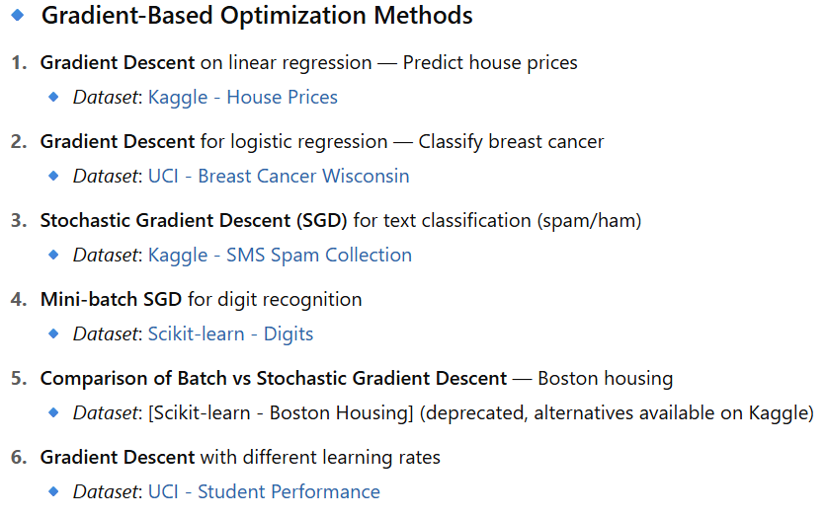
Student-Level Mini Projects

Slide 4
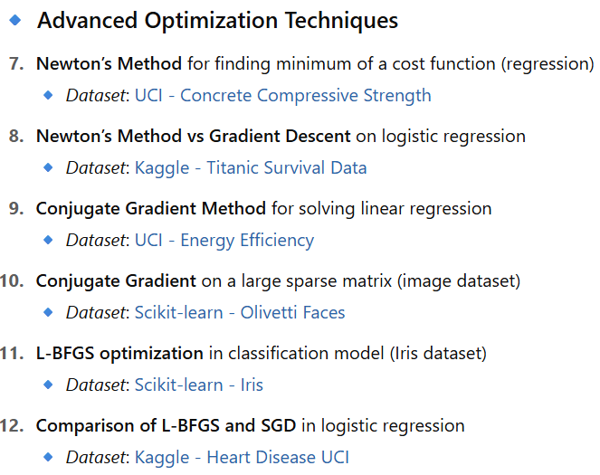
Student-Level Mini Projects

Slide 5
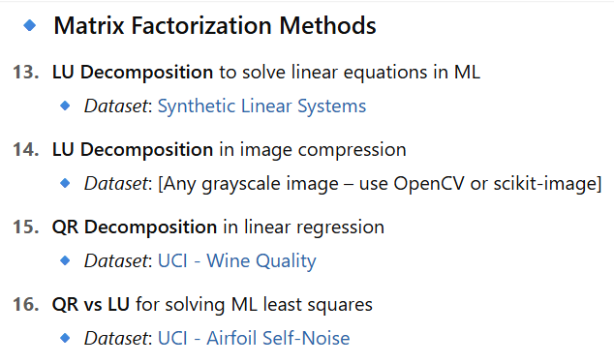
Student-Level Mini Projects

Slide 6
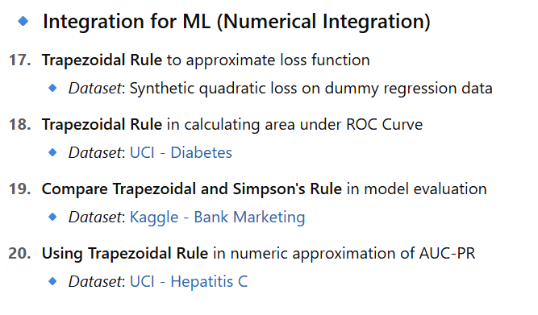
Student-Level Mini Projects

Slide 7
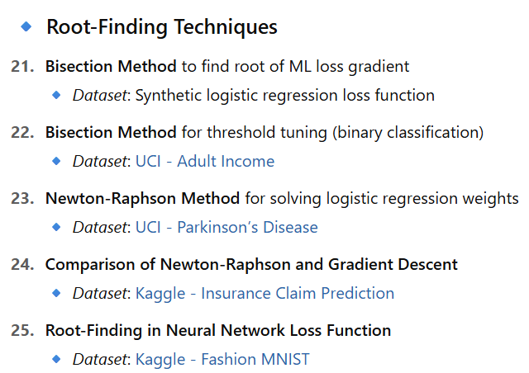
Student-Level Mini Projects

Slide 8
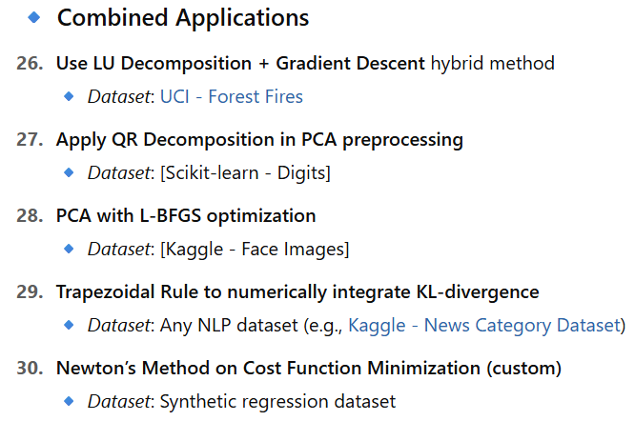
Student-Level Mini Projects

Slide 9
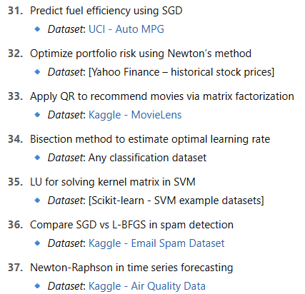
Student-Level Mini Projects

Slide 10
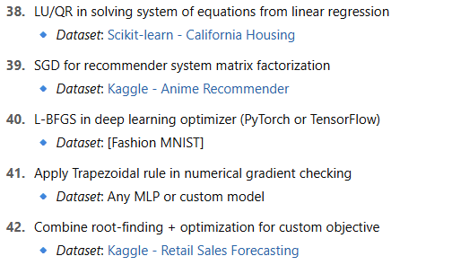
Student-Level Mini Projects

